Slide 1


Autonomous underwater vehicle for sea water intake
tunnel inspection and cleaning for nuclear plant
Review-2
AY 2025-26
Capstone Project – Introduction (PROJ2999)
GITAM (Deemed-to-be) University
Department of Electrical Electronics and Communication Engineering
Project Team:
Polisetty Karthik
N Uday Mahesh Teja
Project Mentor:
Dr. Sunita Panda
Project In-charge:
XXX
www.gitam.edu

Slide 2
Objective and Goals
Objectives
• Inspect seawater intake tunnels: Use sensors and cameras to detect debris,
sedimentation, or other issues that may affect the tunnel's functionality.
• Clean seawater intake tunnels: Utilize cleaning mechanisms or tools to remove debris
and sedimentation, ensuring optimal water flow.
• Navigate through tunnels: Develop navigation algorithms and control systems to
enable the AUV to maneuver through the tunnels efficiently.
• Collect data: Gather data on water quality, flow rates, and tunnel conditions using
various sensors, such as temperature, pH, and pressure sensors.
• Autonomous operation: Autonomous control and navigation, minimizing human
intervention.
Goals
• Robust Communication: Establish reliable communication systems to transmit
data and control commands between the AUV and the surface.
• Reduced Downtime: Minimize downtime and maintenance costs by automating
inspection and cleaning tasks.
• Reliable Inspection: Conduct thorough inspections of seawater intake tunnels to
detect potential issues, such as debris, sedimentation, or damage

Slide 3
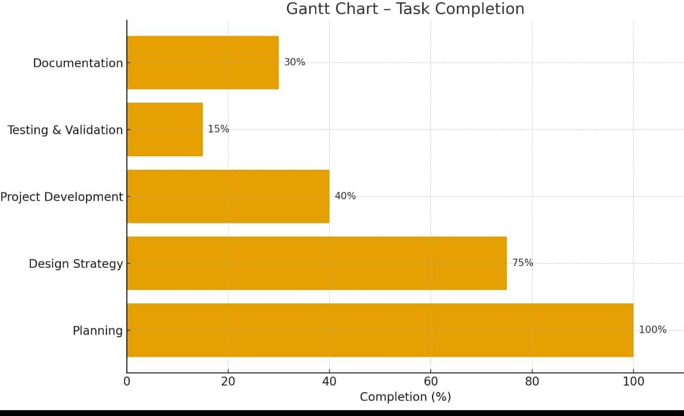
Project Plan

Slide 4
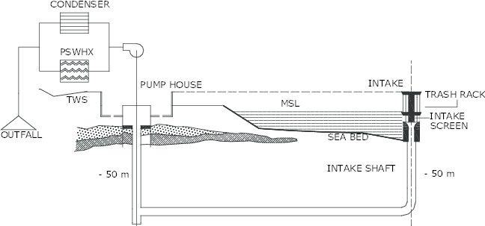

Slide 5
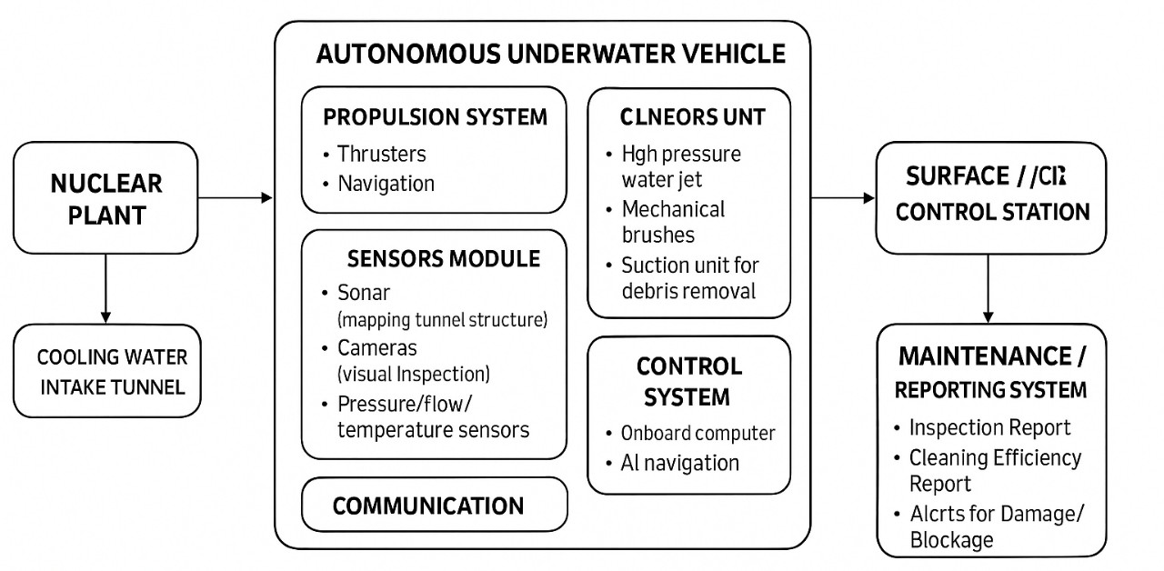
Architecture
Structural Diagram
Block Diagram :

Slide 6
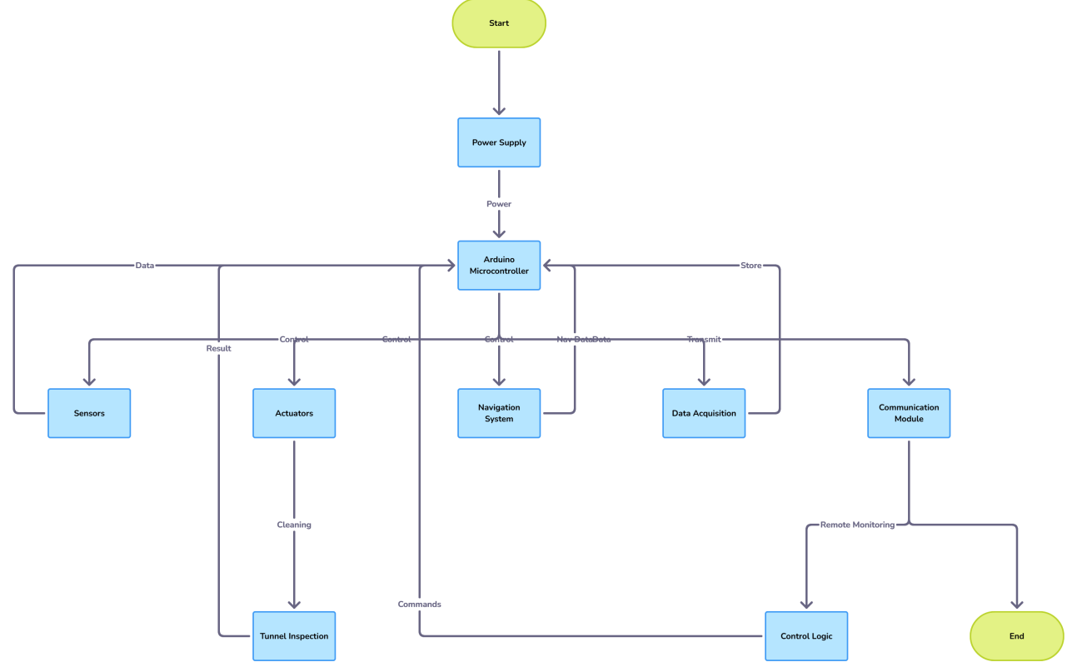
FLOW CHART:

Slide 7
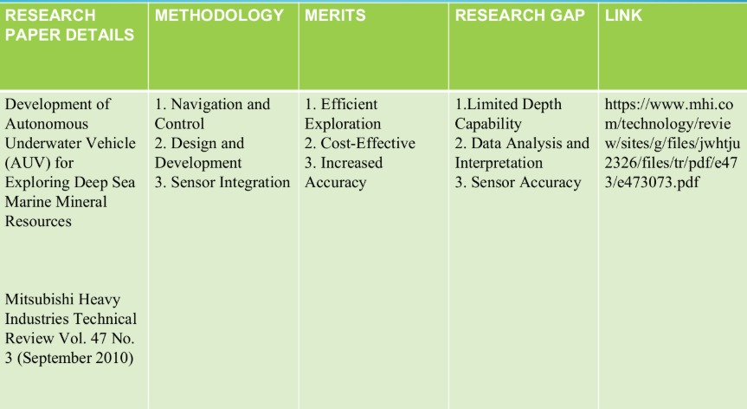
Literature Survey

Slide 8
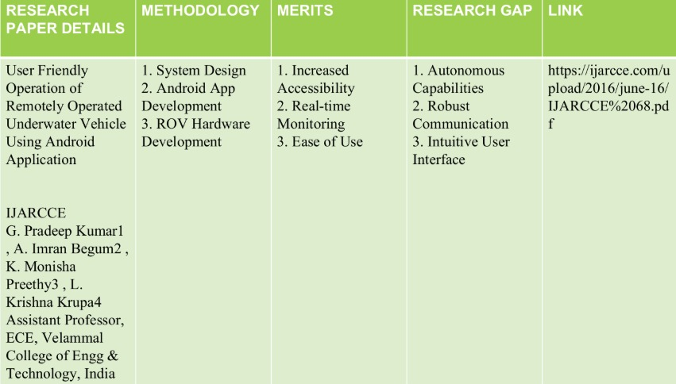

Slide 9
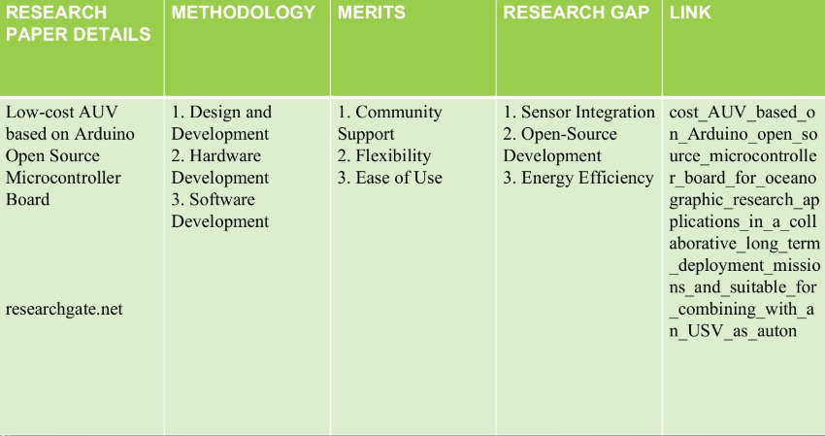
Literature Survey

Slide 10
Use Cases & Testing
Use Cases
∙Biofouling / marine growth: Seaweed, barnacles, molluscs etc. adhere to walls, screens or surfaces, increasing hydraulic resistance (head loss), reducing flow, increasing energy use or lowering cooling capacity.
∙Sedimentation & debris: Sediment buildup, debris or silt accumulation can block inlets, damage screens or filters, or restrict flow, leading to operational issues.
∙Corrosion, cracks, structural degradation: Concrete or metal tunnels may degrade over time; early detection is crucial to avoid catastrophic failure.
∙Clogging of heat exchangers / condensers: If organisms or debris pass through intake systems they can damage or clog cooling tubes.
Test Cases
∙Tunnel traversal & mapping under typical flow: verify that the AUV can traverse the full length of the intake tunnel while mapping geometry and surface condition during normal operational water flow.
∙Cleaning performance: To assess ability of the cleaning tools (brushes, jets, suction) to remove fouling, sediment buildup without damaging surfaces.
∙Redundancy & failure recovery: Test behavior if key systems fail: CPU, sensors, communications, propulsion, etc. Ensure vehicle can self‑rescue or be recovered.

Slide 11
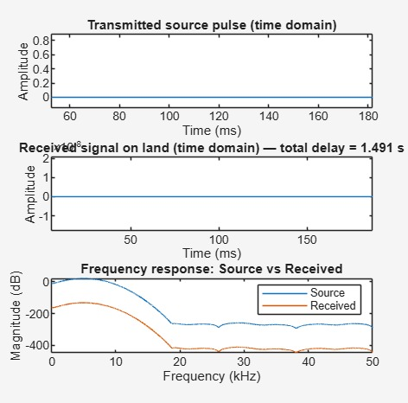
Results :
DEPTH CONTROLLER:
The transmitted source pulse is initially strong, but as it travels underwater, the received signal on land arrives after a significant delay and with much weaker amplitude.
The frequency response plot reveals major attenuation at higher frequencies, indicating underwater environments tend to absorb and weaken high-frequency signals much more than low-frequency ones.
Overall, signals for depth control experience time delays and frequency-dependent loss, which must be addressed in the controller's design to ensure effective underwater vehicle performance

Slide 12
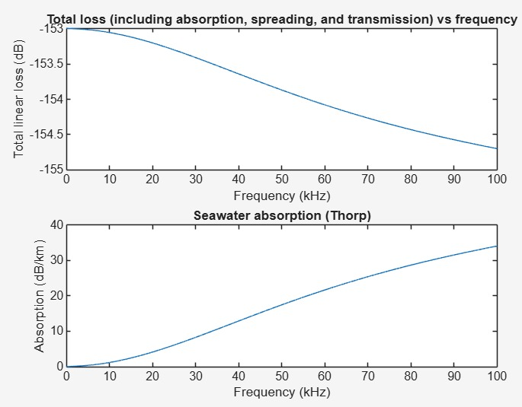
LAND TO SEA COMMUNICATION -
The Problem is Absorption:- This shows the use a higher frequency (a higher-pitched sound, measured in kHz), the seawater absorbs much more energy from the signal. This absorption starts small but increases sharply, reaching over 30 dB/km at 100 kHz.
. High Frequencies Fail:- Because high-frequency signals are absorbed so quickly by the water, the total signal loss (top graph) increases as the frequency goes up.

Slide 13
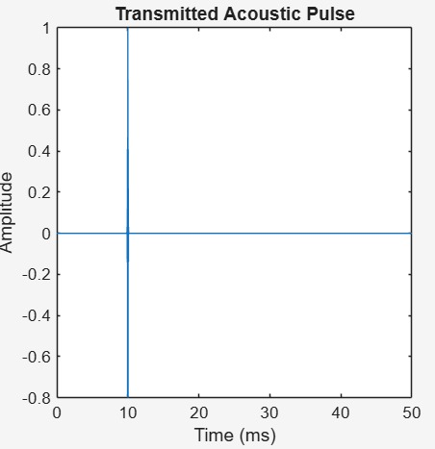
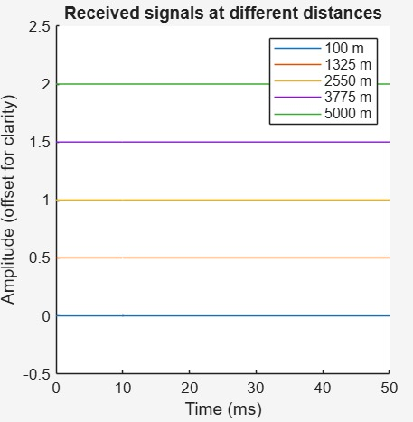
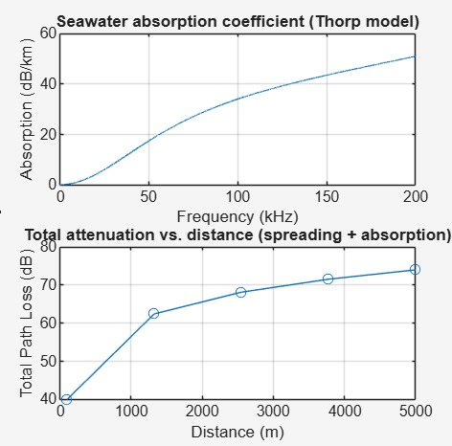
* Underwater acoustic propagation:-
1. Absorption (The Distance Problem)-
Sound gets weaker as it travels through water because the water absorbs its energy. High-pitch (high-frequency) sounds get absorbed very quickly and can’t go far. Low-pitch (low-frequency) sounds travel much farther, which is why they’re used for long-distance underwater communication.
2. Total Signal Loss (The Fading Problem)-
As sound moves through water, it not only gets absorbed but also spreads out in all directions, weakening it even more. This means the farther the sound travels, the weaker it becomes. After about 5 km, most signals lose almost all their strength.

Slide 14
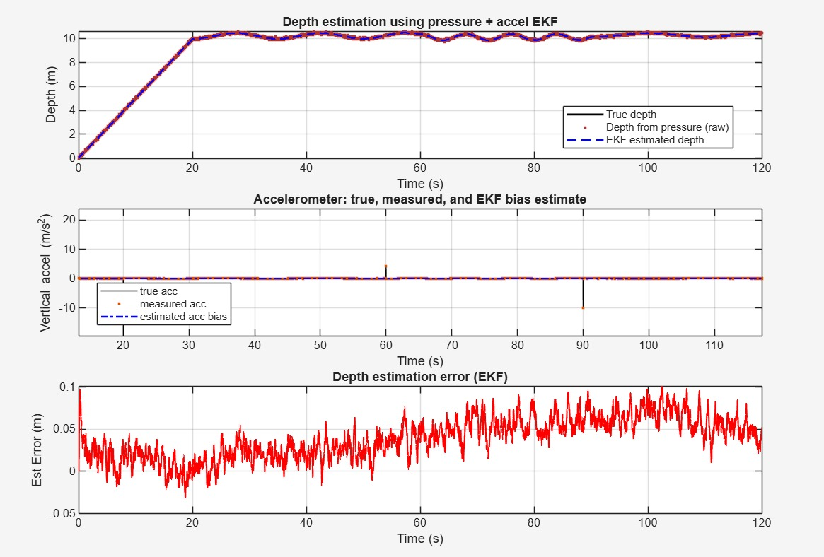
3. Measurement Challenges (The Accuracy Problem)-
Underwater sonar readings are often noisy and unreliable. Some signals bounce off surfaces like the sea floor or the water surface before reaching the receiver — this “multipath” effect causes errors because the sound takes longer to return, leading the system to think the object is farther away than it really is.
* DEPTH ESTIMATION SOALR:

Slide 15
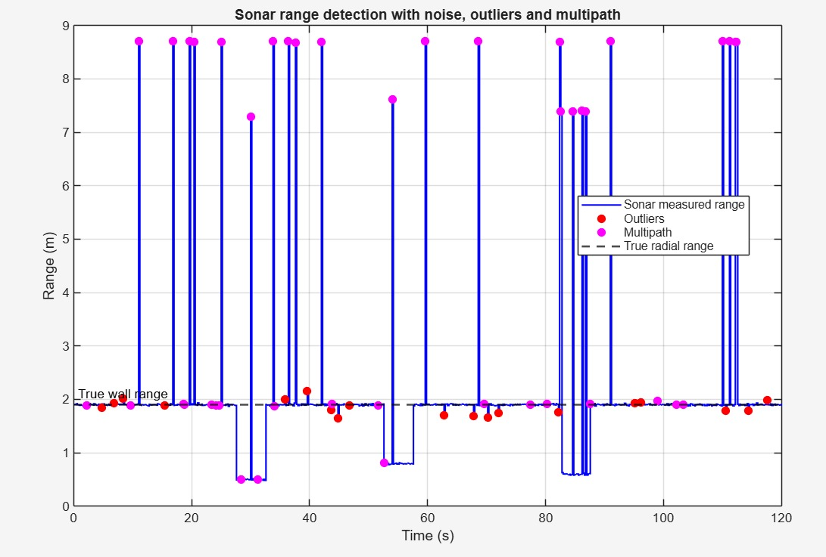
Underwater vehicles need to know their depth very accurately, but each sensor alone can make mistakes.
The two main sensors used are:
  A pressure sensor, which is usually noisy (the readings jump around).
By using EKF, both sensors’ data are combined smartly:
  The EKF smooths out the noisy pressure data using the accelerometer readings.
  The EKF also learns and corrects for the small error in the accelerometer.

Slide 16
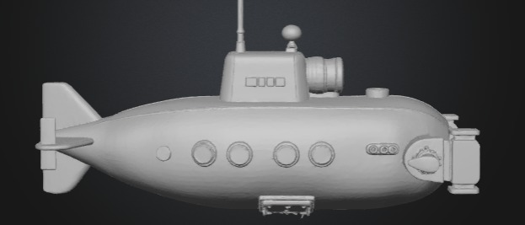
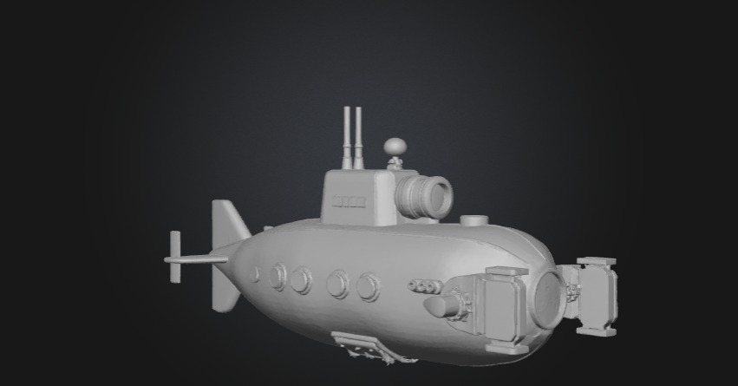

Slide 17
Conclusion & Future Work
Summary and Conclusion
Sea water intake tunnels in nuclear power plants are critical infrastructure. They must allow sufficient cooling water flow, resist marine growth and sediment clogging, and remain structurally sound (no cracks, corrosion or deformation). Maintenance and inspection are mandatory for safety, regulatory compliance, and operational efficiency.
It is feasible to design, prototype or simulate an AUV system that can perform inspection (mapping + defect detection, e.g. siltation or cracks) in a controlled or scaled test environment. Designing full‑scale cleaning capability under realistic nuclear plant conditions is more challenging but possible with careful trade‑offs.
Future Work
Advanced Sensor Fusion for Improved Localization
Autonomous/Adaptive Cleaning Mechanisms
Energy Efficiency & Longer Mission Duration

Slide 18
THANK YOU
Have a Great Day !

